Slide 1


Lab 2
Linear Regression
With TF 1.0!
Sung Kim <hunkim+ml@gmail.com>
Code: https://github.com/hunkim/DeepLearningZeroToAll/

Slide 2

Call for comments
Please feel free to add comments directly on these slides
Other slides: https://goo.gl/jPtWNt
Picture from http://www.tssablog.org/archives/3280

Slide 3
Lab 2
Linear Regression
With TF 1.0!
Sung Kim <hunkim+ml@gmail.com>
Code: https://github.com/hunkim/DeepLearningZeroToAll/

Slide 4
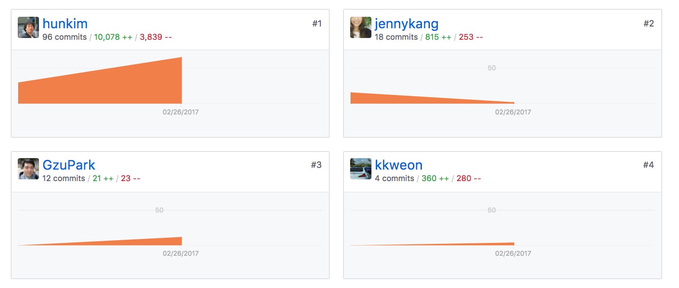
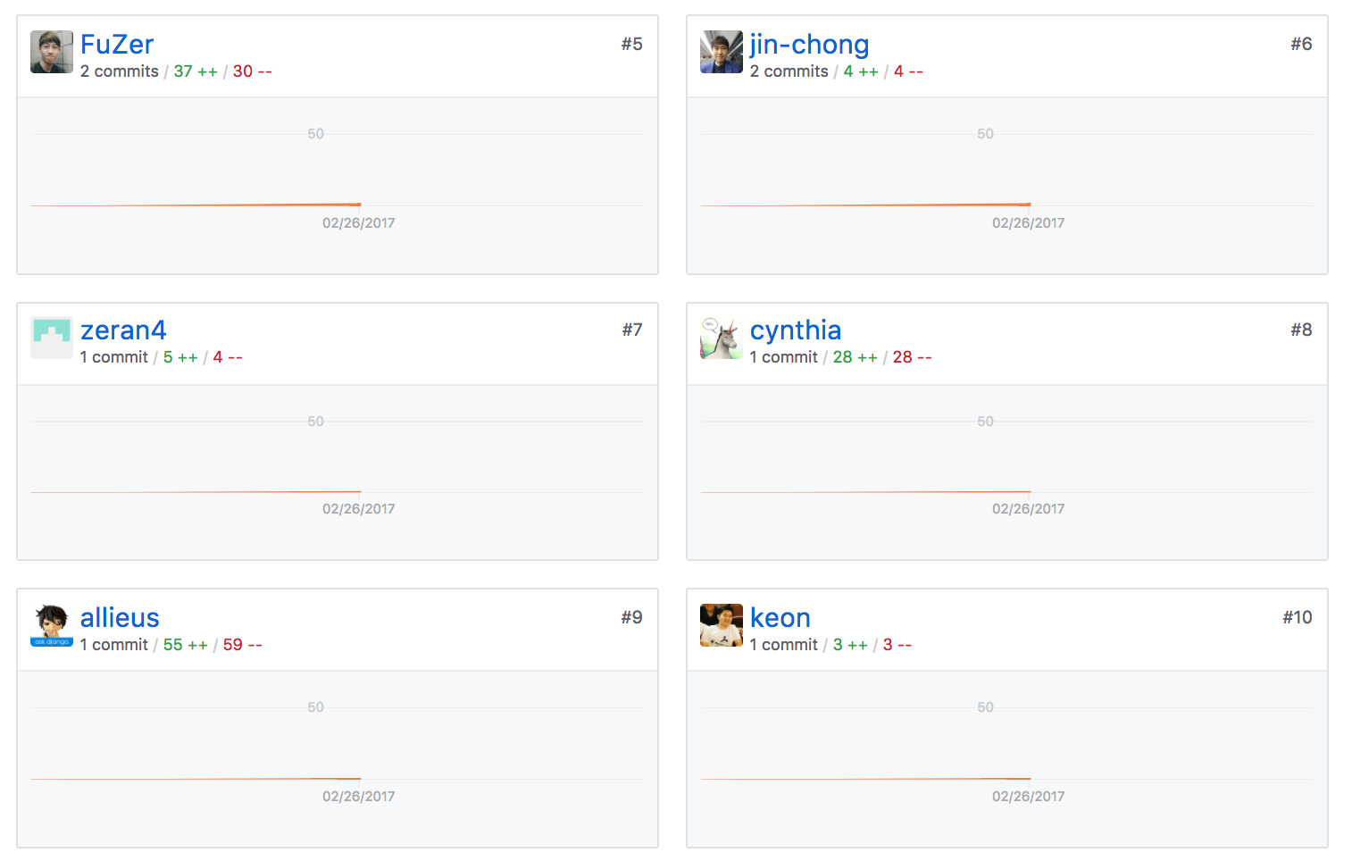
https://github.com/hunkim/DeepLearningZeroToAll/

Slide 5


Hypothesis and cost function

Slide 6


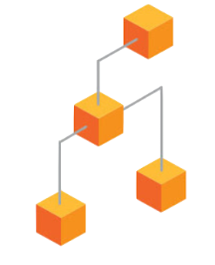



TensorFlow Mechanics
feed data and run graph (operation) sess.run (op, feed_dict={x: x_data})
Build graph using
TensorFlow operations
update variables
in the graph
(and return values)

Slide 7
Build graph using TF operations
# X and Y data
x_train = [1, 2, 3]
y_train = [1, 2, 3]
W = tf.Variable(tf.random_normal([1]), name='weight')
b = tf.Variable(tf.random_normal([1]), name='bias')
# Our hypothesis XW+b
hypothesis = x_train * W + b
# cost/loss function
cost = tf.reduce_mean(tf.square(hypothesis - y_train))

Slide 8

Build graph using TF operations
# cost/loss function
cost = tf.reduce_mean(tf.square(hypothesis - y_train))
GradientDescent
# Minimize
optimizer = tf.train.GradientDescentOptimizer(learning_rate=0.01)
train = optimizer.minimize(cost)
https://www.tensorflow.org/api_docs/python/tf/reduce_mean

Slide 9
Run/update graph and get results
# Launch the graph in a session.
sess = tf.Session()
# Initializes global variables in the graph.
sess.run(tf.global_variables_initializer())
# Fit the line
for step in range(2001):
sess.run(train)
if step % 20 == 0:
print(step, sess.run(cost), sess.run(W), sess.run(b))

Slide 10
import tensorflow as tf
# X and Y data
x_train = [1, 2, 3]
y_train = [1, 2, 3]
W = tf.Variable(tf.random_normal([1]), name='weight')
b = tf.Variable(tf.random_normal([1]), name='bias')
# Our hypothesis XW+b
hypothesis = x_train * W + b
# cost/loss function
cost = tf.reduce_mean(tf.square(hypothesis - y_train))
# Minimize
optimizer = tf.train.GradientDescentOptimizer(learning_rate=0.01)
train = optimizer.minimize(cost)
# Launch the graph in a session.
sess = tf.Session()
# Initializes global variables in the graph.
sess.run(tf.global_variables_initializer())
# Fit the line
for step in range(2001):
sess.run(train)
if step % 20 == 0:
print(step, sess.run(cost), sess.run(W), sess.run(b))
Full code (less than 20 lines)
'''
0 2.82329 [ 2.12867713] [-0.85235667]
20 0.190351 [ 1.53392804] [-1.05059612]
40 0.151357 [ 1.45725465] [-1.02391243]
...
1920 1.77484e-05 [ 1.00489295] [-0.01112291]
1940 1.61197e-05 [ 1.00466311] [-0.01060018]
1960 1.46397e-05 [ 1.004444] [-0.01010205]
1980 1.32962e-05 [ 1.00423515] [-0.00962736]
2000 1.20761e-05 [ 1.00403607] [-0.00917497]
'''

Slide 11
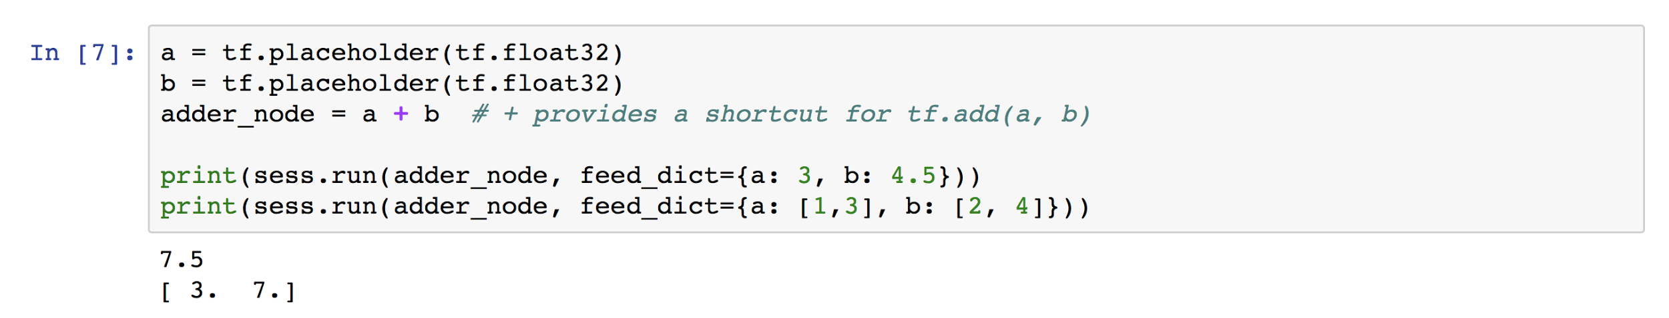
Placeholders
https://github.com/hunkim/DeepLearningZeroToAll/blob/master/lab-01-basics.ipynb

Slide 12
Placeholders
# X and Y data
x_train = [1, 2, 3]
y_train = [1, 2, 3]
# Now we can use X and Y in place of x_data and y_data
# # placeholders for a tensor that will be always fed using feed_dict
# See http://stackoverflow.com/questions/36693740/
X = tf.placeholder(tf.float32)
Y = tf.placeholder(tf.float32)
...
# Fit the line
# Fit the line
for step in range(2001):
cost_val, W_val, b_val, _ = \
sess.run([cost, W, b, train],
feed_dict={X: [1, 2, 3], Y: [1, 2, 3]})
if step % 20 == 0:
print(step, cost_val, W_val, b_val)

Slide 13
import tensorflow as tf
W = tf.Variable(tf.random_normal([1]), name='weight')
b = tf.Variable(tf.random_normal([1]), name='bias')
X = tf.placeholder(tf.float32, shape=[None])
Y = tf.placeholder(tf.float32, shape=[None])
# Our hypothesis XW+b
hypothesis = X * W + b
# cost/loss function
cost = tf.reduce_mean(tf.square(hypothesis - Y))
# Minimize
optimizer = tf.train.GradientDescentOptimizer(learning_rate=0.01)
train = optimizer.minimize(cost)
# Launch the graph in a session.
sess = tf.Session()
# Initializes global variables in the graph.
sess.run(tf.global_variables_initializer())
# Fit the line
for step in range(2001):
cost_val, W_val, b_val, _ = sess.run([cost, W, b, train],
feed_dict={X: [1, 2, 3], Y: [1, 2, 3]})
if step % 20 == 0:
print(step, cost_val, W_val, b_val)
Full code with placeholders
...
1980 1.32962e-05 [ 1.00423515] [-0.00962736]
2000 1.20761e-05 [ 1.00403607] [-0.00917497]
# Testing our model
print(sess.run(hypothesis, feed_dict={X: [5]}))
print(sess.run(hypothesis, feed_dict={X: [2.5]}))
print(sess.run(hypothesis,
feed_dict={X: [1.5, 3.5]}))
[ 5.0110054]
[ 2.50091505]
[ 1.49687922 3.50495124]

Slide 14
import tensorflow as tf
W = tf.Variable(tf.random_normal([1]), name='weight')
b = tf.Variable(tf.random_normal([1]), name='bias')
X = tf.placeholder(tf.float32, shape=[None])
Y = tf.placeholder(tf.float32, shape=[None])
# Our hypothesis XW+b
hypothesis = X * W + b
# cost/loss function
cost = tf.reduce_mean(tf.square(hypothesis - Y))
# Minimize
optimizer = tf.train.GradientDescentOptimizer(learning_rate=0.01)
train = optimizer.minimize(cost)
# Launch the graph in a session.
sess = tf.Session()
# Initializes global variables in the graph.
sess.run(tf.global_variables_initializer())
# Fit the line with new training data
for step in range(2001):
cost_val, W_val, b_val, _ = sess.run([cost, W, b, train],
feed_dict={X: [1, 2, 3, 4, 5],
Y: [2.1, 3.1, 4.1, 5.1, 6.1]})
if step % 20 == 0:
print(step, cost_val, W_val, b_val)
Full code with placeholders
…
1960 3.32396e-07 [ 1.00037301] [ 1.09865296]
1980 2.90429e-07 [ 1.00034881] [ 1.09874094]
2000 2.5373e-07 [ 1.00032604] [ 1.09882331]
# Testing our model
print(sess.run(hypothesis, feed_dict={X: [5]}))
print(sess.run(hypothesis, feed_dict={X: [2.5]}))
print(sess.run(hypothesis,
feed_dict={X: [1.5, 3.5]}))
[ 6.10045338]
[ 3.59963846]
[ 2.59931231 4.59996414]

Slide 15
TensorFlow Mechanics
feed_dict={X: [1, 2, 3, 4, 5],
Y: [2.1, 3.1, 4.1, 5.1, 6.1]})
feed data and run graph (operation) sess.run (op, feed_dict={x: x_data})
Build graph using
TensorFlow operations
update variables
in the graph
(and return values)

Slide 16
Lab 3
Minimizing Cost
With TF 1.0!
Sung Kim <hunkim+ml@gmail.com>

